Slide 1
Cyber Security
Lecture 1: Introduction

Slide 2
Grading Policy
Your final grade will be calculated as follows:
  Term Work: Assignments / Homework / Quizzes / Midterm exam (20 points)
  Lab Exams (20 points)
  Oral Exam, Attendance and Participation (20 points)
    How to participate?
      Ask questions
      Answer questions
      Make comments
  Final Exam (25/6/2011) (90 points)
<number>/32

Slide 3
Grading Rules
Final exam is cancelled if attendance < %75
If final exam grade is less than %30, your final grade will be just your final exam grade.
<number>/32

Slide 4
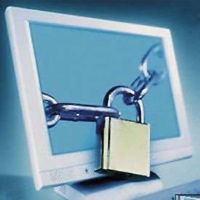
Computer Security
<number>/26

Slide 5
Contents
Introduction
  What is Computer Security
  Scope of Computer Security
  Cryptography & Computer Security
  The OSI Security Architecture
  Model for Computer Network Security
<number>/32

Slide 6
Computer Security
Computer security protection affordedتوفير to an automated information system in order to attain تحقيقthe applicable objectives of preserving المحافظه علىthe confidentialityالسرية, integrityالنزاهه, and availability توفرof information system resources (includes hardware, software, information/data, and telecommunications)..
<number>/32
Notes:
Hardware - A major threat = is the threat to availability. Hardware is the most vulnerable to attack and the least susceptible to automated controls. Threats include accidental and deliberate damage to equipment as well as theft. Theft of CDROMs and DVDs can lead to loss of confidentiality. Physical and administrative security measures are needed to deal with these threats.
Software - includes the operating system, utilities, and application programs. A key threat is an attack on availability. Software is often easy to delete. Software can also be altered or damaged to render it useless. Careful software configuration management can maintain high availability. A more difficult problem is software modification (e.g. from virus/worm) that results in a program that still functions but that behaves differently than before, which is a threat to integrity/authenticity.
Data - involves files and other forms of data controlled by individuals, groups, and business organizations. Security concerns with respect to data are broad, encompassing availability, secrecy, and integrity. In the case of availability, the concern is with the destruction of data files, which can occur either accidentally or maliciously. The obvious concern with secrecy is the unauthorized reading of data files or databases. A less obvious secrecy threat involves the analysis of data and manifests itself in the use of so-called statistical databases, which provide summary or aggregate information. Finally, data integrity is a major concern in most installations. Modifications to data files can have consequences ranging from minor to disastrous.

Slide 7

Computer Security & CIA
Confidentialityالسرية: Preservingالحفاظ على authorizedمخول restrictionsقيود on information access and disclosure افشاء
Integrityالسلامة: Guardingحراسة against improper information modification or destructionتدميرها.
Availabilityالتوفير: Ensuring timelyضمان الوصول فى الوقت المناسب and reliable access to and use of information.
Authenticity اصلية : The property of being genuineحقيقيةand being able to be verified and trusted
Accountabilityالمسألة: The security goal الهدف الأمنىthat generates the requirement for actions of an entityشخصى to be traced uniquely to that entity.
<number>/32

Slide 8
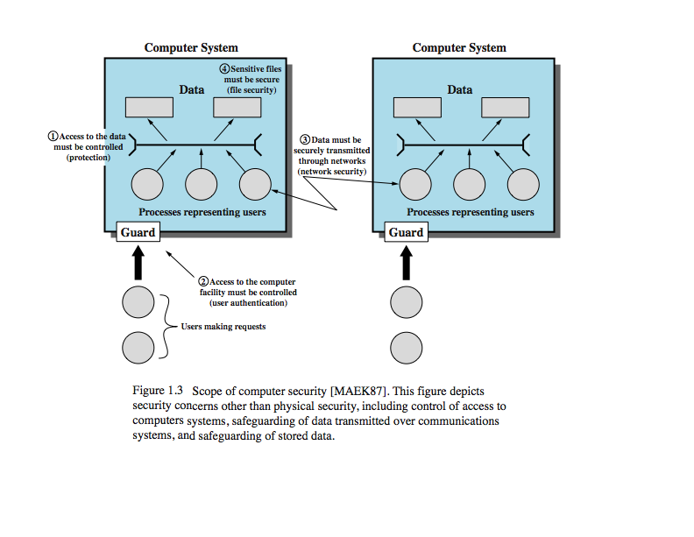
Scope of Computer Security
<number>/32

Slide 9
Related Computer Security Topics
Access Control: deals with authentication التوثيقand authorizationالتفويض
Network Security
Software Security: OS security, security flaws and malwareثغرات أمنية والبرمجيات الخبيثة
<number>/32

Slide 10
Why Computer Security?
One Web page being infected every five seconds
29.7 billion pages on the World Wide Web as of February 2017.
An average of more than 15,000 newly infected web pages each day from 1 January to 31 March 2018.
<number>/32

Slide 11
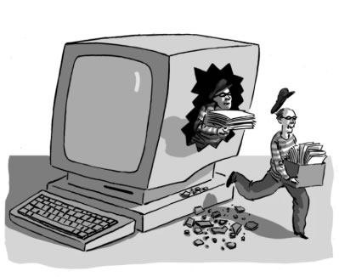
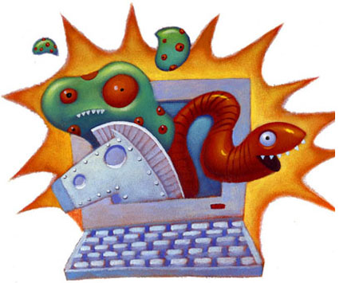
Examples of security violationsانتهاكات
<number>/32

Slide 12
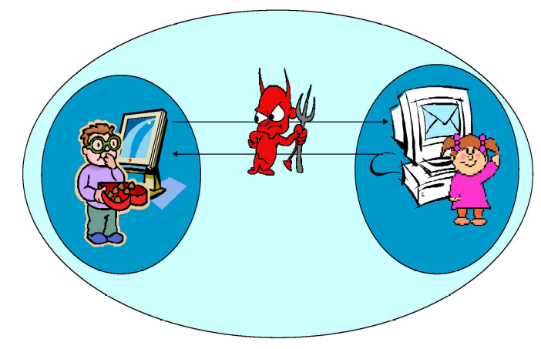
Examples of security violations (1)
User A transmits a file to user B. The file contains sensitive information.
User C, who is not authorized to read the file, is able to monitor the transmission and capture a copy of the file during its transmission.
<number>/32

Slide 13
Examples of security violations (2)
A network manager, D, transmits a message to a computer, E, under its management.
The message instructs يرشد computer E to update an authorization file to include the identities of a number of new users who are to be given access to that computer.
User F interceptsيعترض the message, altersيغير its contents to add or delete entries
User F forwards the message to E, which accepts the message as coming from manager D and updates its authorization file accordinglyوفقا لذلك.
<number>/32

Slide 14
Examples of security violations (3)
Rather than intercept يعترضa message, user F constructsيبنى its own message with the desired entries and transmits that message to E as if it had come from manager D.
Computer E accepts the message as coming from manager D and updates its authorization file accordingly
<number>/32

Slide 15
The OSI Security Architecture
ITUاسم مؤسسة-T Recommendation X.800, Security Architecture for OSI, defines requirements for security.
  Security service
  Security mechanism
  Security attack
<number>/32
Notes:
The International Telecommunication Union (ITU) Telecommunication Standardization

Slide 16
Security service
Authenticationالتوثيق: The assuranceالتوكيد that the communicating entity is the one that it claimsالمطالبات to be.
Access Control: The prevention of unauthorized use of a resource.
Data Confidentiality: The protection of data from unauthorized غير مصرح له disclosureافشاء .
Data Integrityالسلامة: The assurance that data received are exactly as sent by an authorized entity (i.e., contain no modification, insertion, deletion, or replay).
Nonrepudiationعدم انكار: Provides protection against denialانكار by one of the entities involved in a communication of having participated in all or part of the communication
Availabilityتوفر: The property of a system or a system resource being accessible and usable upon demand الطلبby an authorized system entity, according to performance specifications for the system.
<number>/32

Slide 17
Security Mechanisms
There is one particularبصفه خاصه element that underlies many of security mechanisms in use: CRYPTOGRAPHY
CRYPTO
GRAPHY
Hidden
Writing
<number>/32

Slide 18
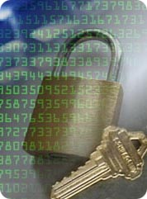
Cryptography & Computer Security
An important element in many computer security services and applications is the use of cryptographic algorithms
Cryptography is the most fundamental Computer security tool.
Cryptography has many uses, including the protection of confidentiality and integrity, among many other vitalحيوى Computer security functions.
<number>/32

Slide 19
Security attack
Attacksهجمات are classified in terms of passive attacks and active attacks.
  A passive attack attempts محاولاتto learn or make use of information from the system but does not affectتؤثر system resourcesمصادر.
  An active attack attempts to alterتغير system resources or affect their operation.
<number>/32

Slide 20
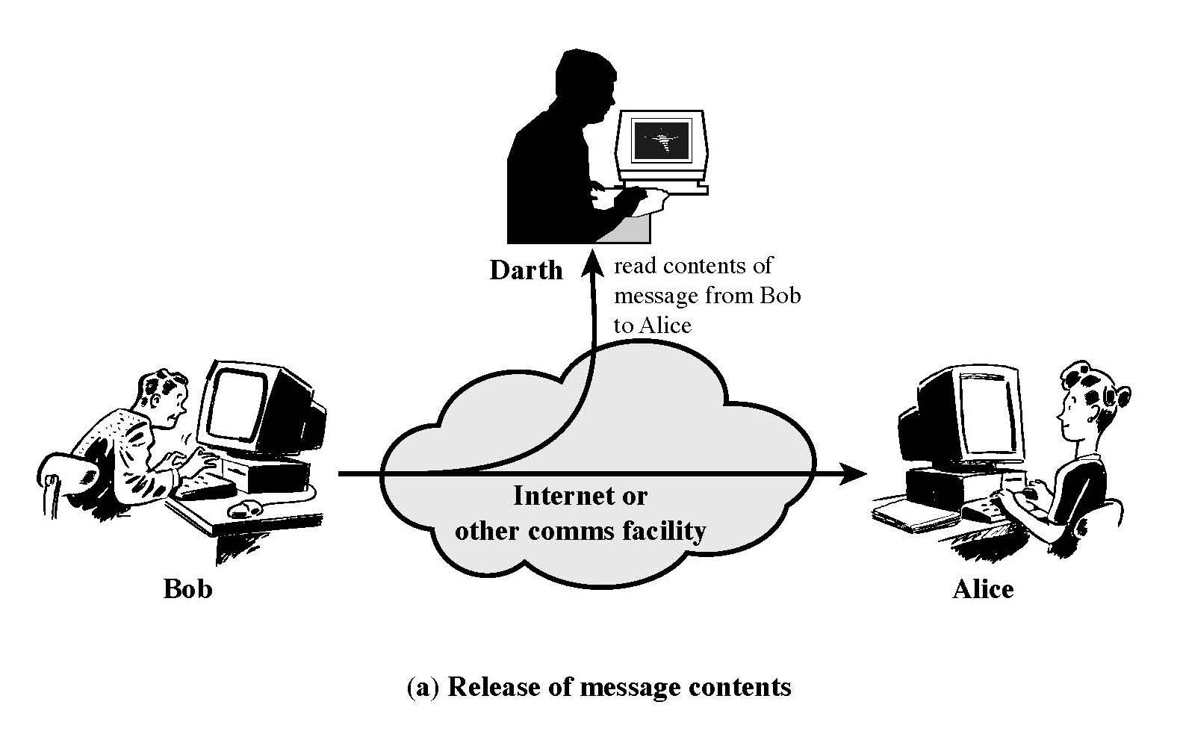
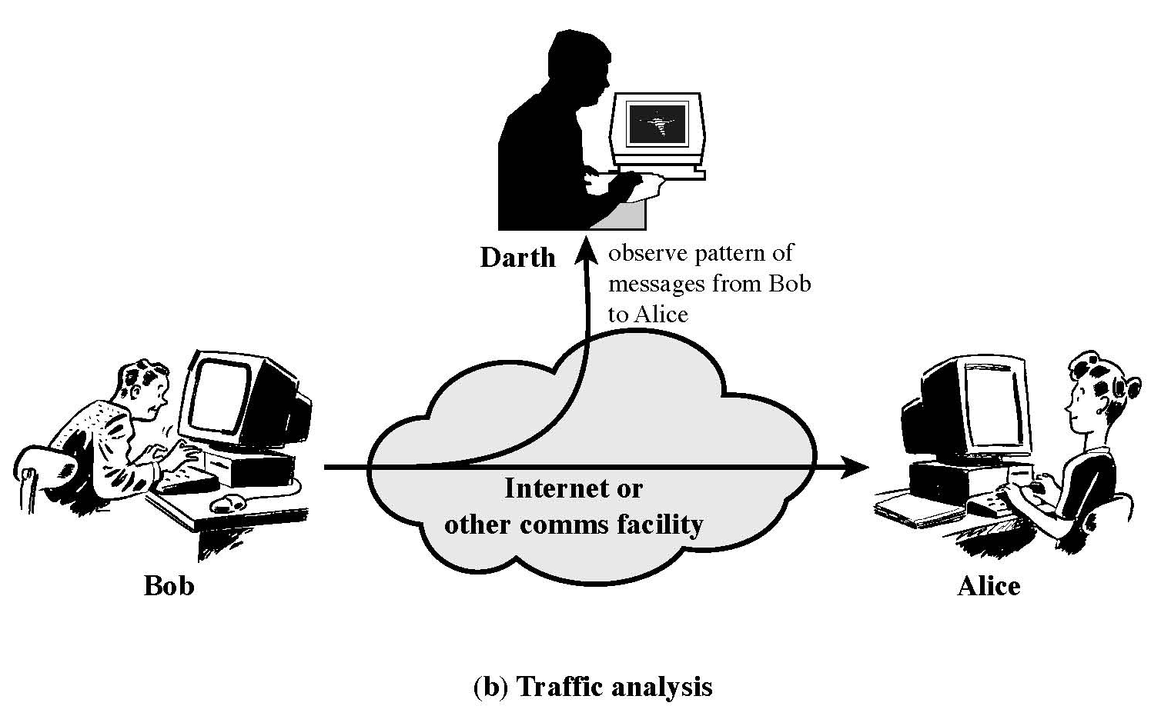
Attacks: Passive Attacks
<number>/32

Slide 21
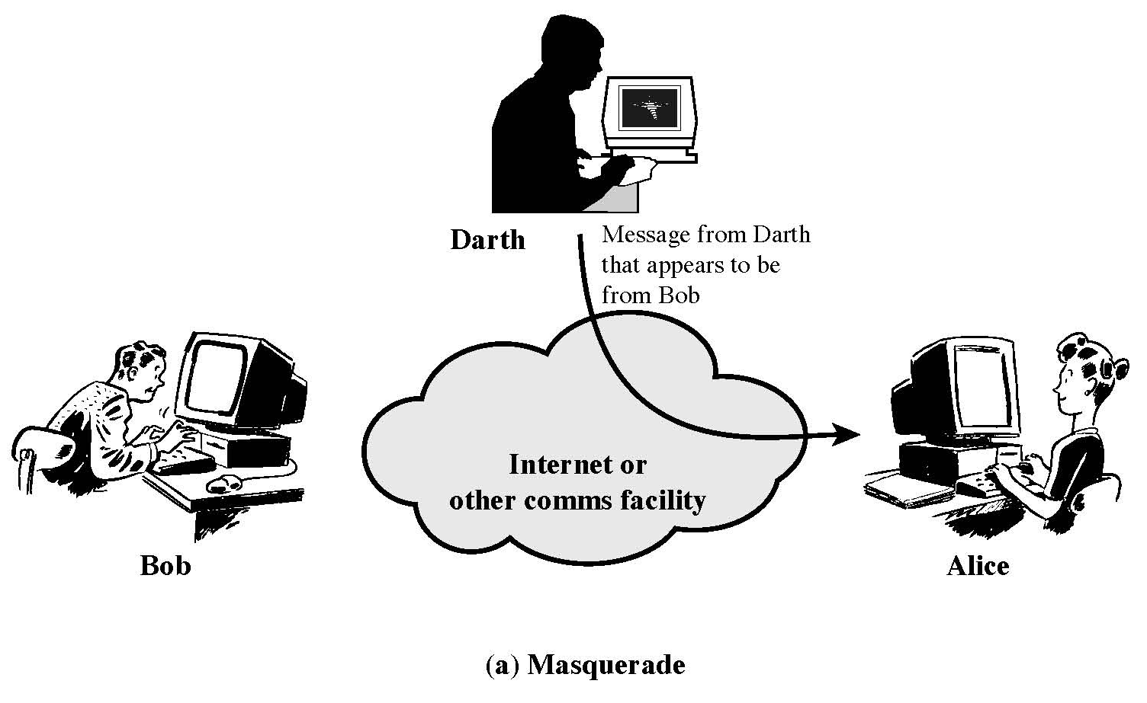
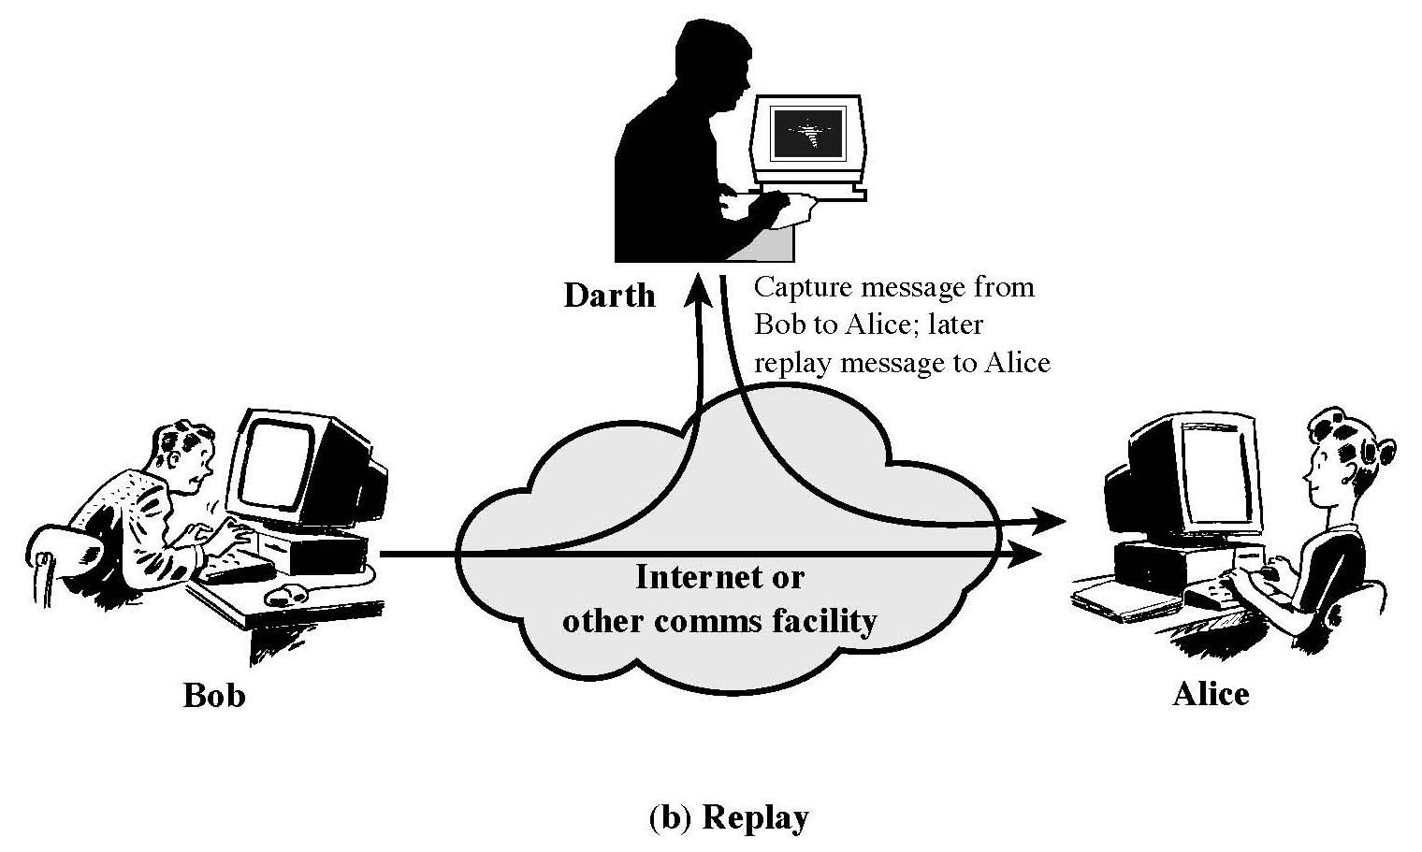
Attacks: Active Attacks
<number>/32

Slide 22
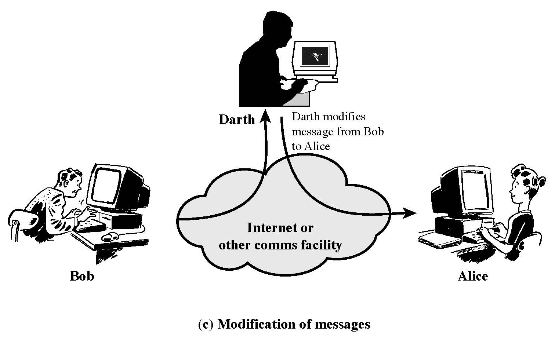
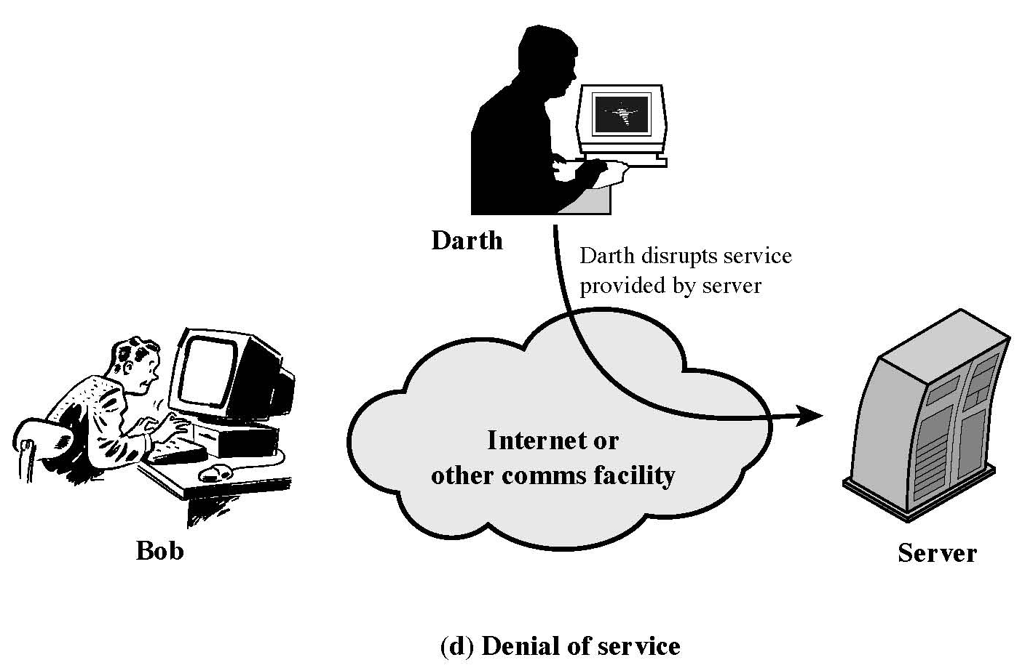
Attacks: Active Attacks
<number>/32

Slide 23
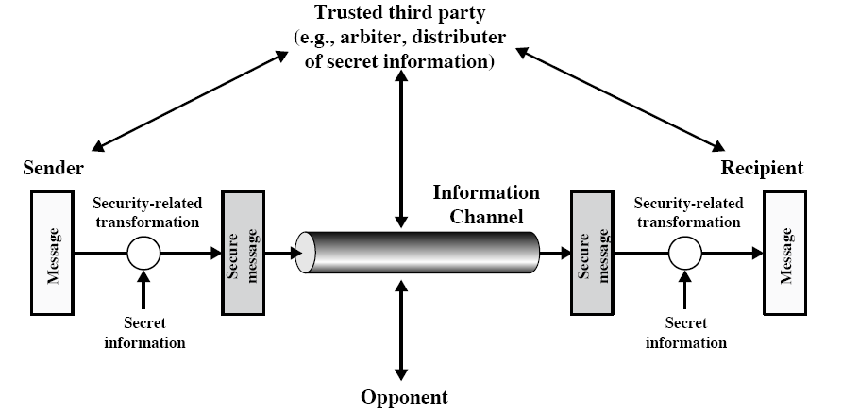
Model for Network Security
<number>/32

Slide 24
Model for Computer Network Security
Using this model requires us to:
  design a suitable algorithm for the security transformation
  generate the secret information (keys) used by the algorithm
  develop طورmethods to distribute and share the secret information
  specify يحددa protocol enabling the principals to use the transformation and secret information for a security service
<number>/32

Slide 25
Summary
  What is Computer Security
  Scope of Computer Security
  Cryptography & Computer Security
  The OSI Security Architecture
  Model for Computer Network Security
<number>/32

Slide 26
Thank You . . .
<number>/32

